Slide 1
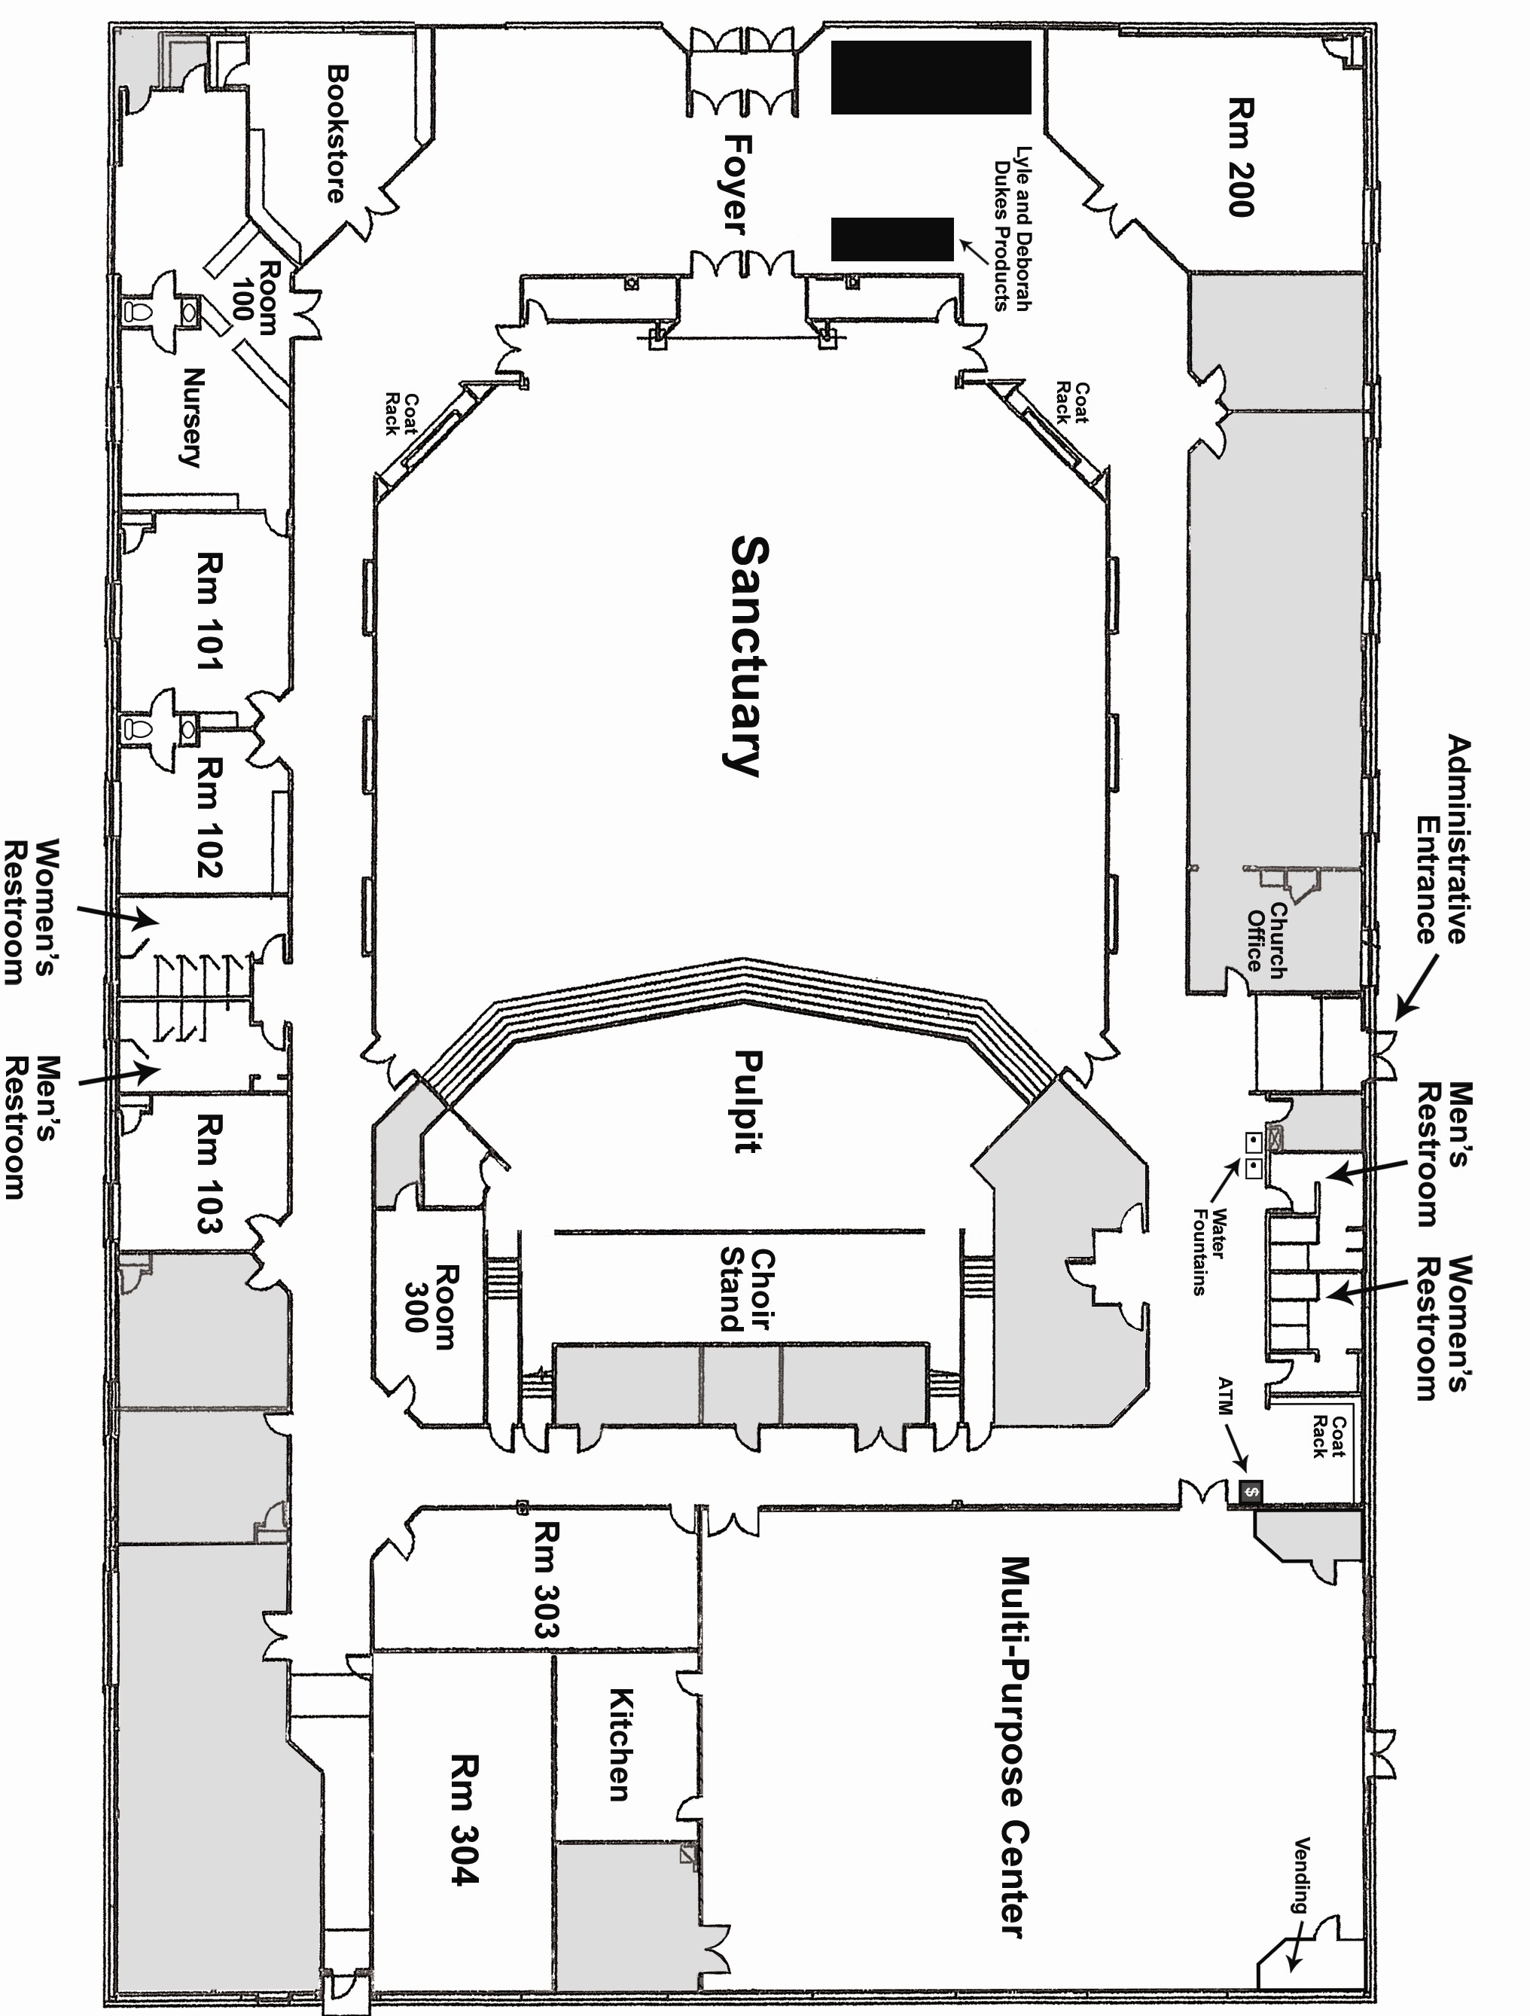
HARVEST LIFE CHURCH DIAGRAM
The Marketplace
The Meeting Room
Baby & Me
Sanctuary
AVAILABLE FURNITURE
TABLES
72 - 8 ft White Tables
25 – 6 ft White Tables
5 – 6 ft Black Tables
35 – Round Tables
8 – High Boy Tables
CHAIRS
196 – White Chairs
20 – Black Chairs
Room
301
The Life Center
Room 104
Stage
Instruments

